Slide 1


SecurGuard Pro
Kiet Group of Institutions
Project: Plant Vision

Slide 2
Problem Statement:
Traditional crop identification methods are time-consuming and require specialized knowledge. Our app aims to simplify the process by leveraging AI and ML algorithms.

Slide 3
Objective of the Application
Create a user-friendly mobile app that enables farmers and agricultural enthusiasts to easily identify various crops by simply capturing a photo using their smartphones.

Slide 4
Key Features of the AI-based Crop Identification Mobile Application
Real-Time Identification
Instantly identify crops by analyzing field photos using advanced AI algorithms.
Multiple Crop Support
Demonstrate identification capabilities for at least 10 different crops to cater to diverse agricultural needs.
Geolocation Integration
Automatically capture geolocation data to provide location-specific crop information.
Data Storage & Export
Store crop photos, identification results, and geolocation information in an external and internal database for record-keeping. Export or email stored data as needed.

Slide 5
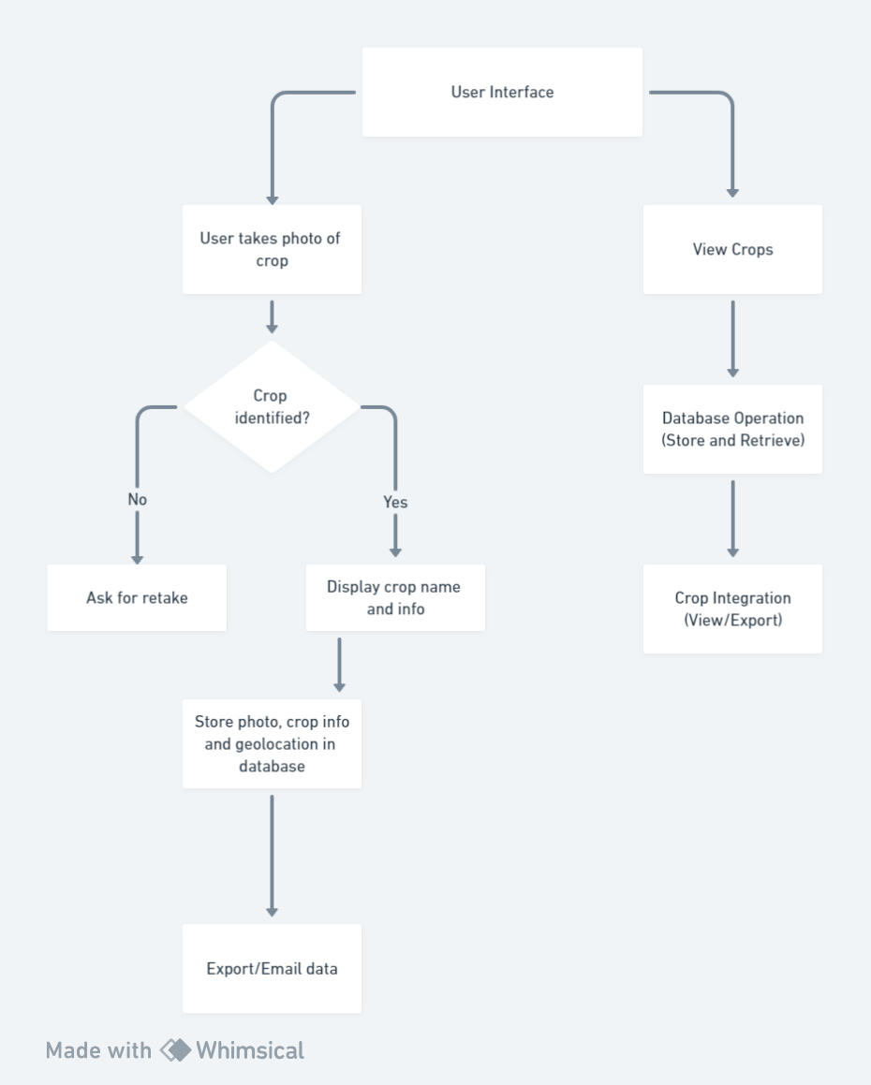
Workflow:

Slide 6
Tech Stack:
Frontend: Flutter SDK
Backend: Django, dbsqlite3
Python, Machine learning and learning libraries
OpenCv, Arduino

Slide 7
Technical Requirements and Challenges
Implement state-of-the-art AI and ML models to ensure accurate crop identification.
Optimize app performance to handle real-time photo analysis without compromising user experience.
Address app compatibility issues across different smartphone platforms.
Ensure data privacy and security in storing user information.
Creating robust database for storage and retrieval of data.

Slide 8
Data Storage and Export Functionality
The mobile application securely stores crop photos, identification results, and geolocation information in an external and internal database, enabling users to retrieve and analyze data at any time.
Users can export or email stored data for further analysis or sharing with agricultural experts.

Slide 9
Conclusion and Future Developments
The AI-based crop identification app revolutionizes crop management by providing farmers with an efficient tool that simplifies the identification process. Future developments may include additional features like disease detection, yield prediction and integration of AR.

